Slide 1
July 24, 2023
UNDERSTANDING
TELCO CHURN:
A DATA DRIVEN ANALYSIS
Presentation by: Krittika Deshwal Carson Mullen
Sanjana Nayak
Sanjhana Rangaraj
Cassie Ren

Slide 2
1
4
OBJECTIVE OF THE STUDY
INTERPRETATION OF RESULTS
STRATEGIES & IMPLEMENTATION
2
5
EXPLORATORY DATA ANALYSIS
CONCLUSION
FEATURE IMPORTANCE & CORRELATION
ENABLING BUSINESS IMPACT
3
6
STATISTICAL MODELS EMPLOYED
Q&A
MEASURES OF SUCCESS AND MODEL COMPARISON

Slide 3

OBJECTIVE OF THE STUDY
What’s causing this telcom company to lose customers?
What can they do about it?

Slide 4
EXPLORATORY DATA ANALYSIS

Slide 5
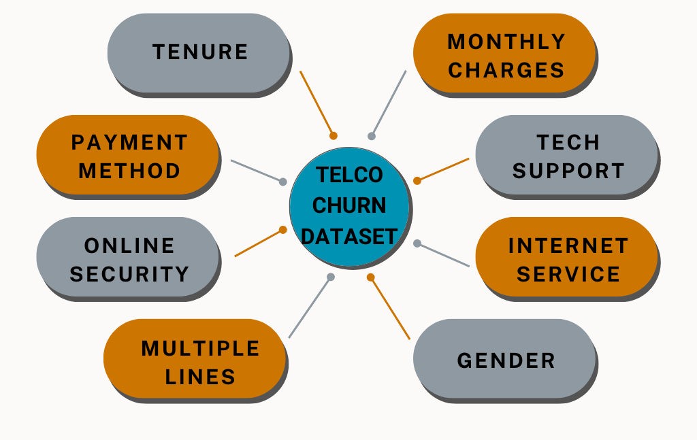
TELECOM CHURN DATASET
Notes:
Insert snapshot of dataset/explain variables

Slide 6
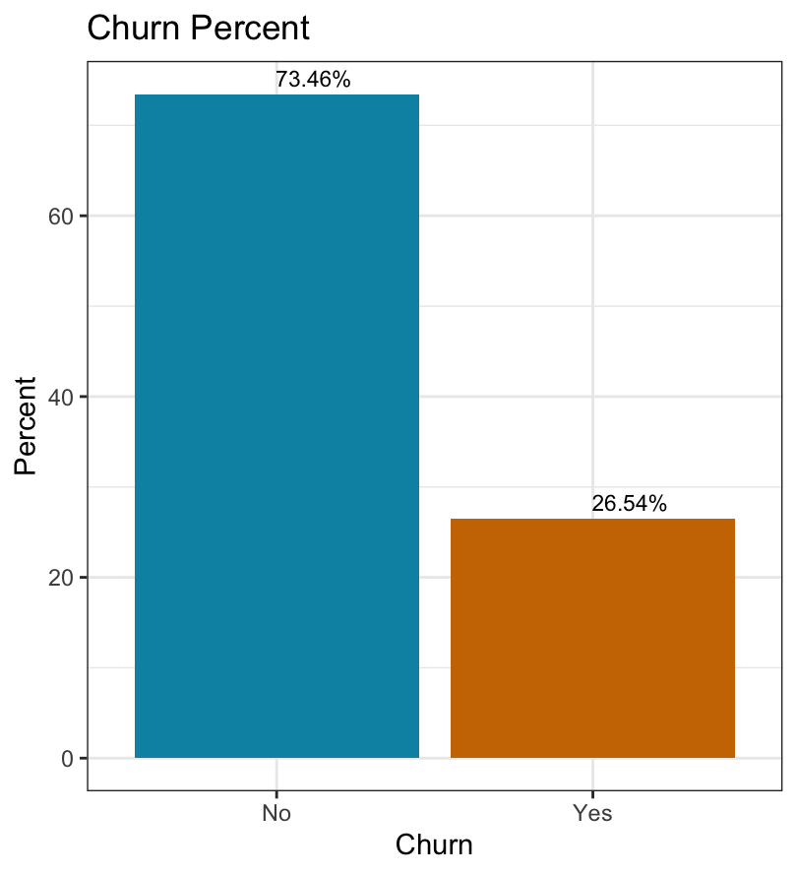
CHURN PERCENT
Notes:
Add visualizations - ALL ON ONE SLIDE! Hoping for 3 charts that we can put on here, but we can spread it out to 3 slides as well.
churn vs no churn customers
identify any initial patterns/relationships we saw from random visuzlizations
variable importance
correlation heatmap

Slide 7
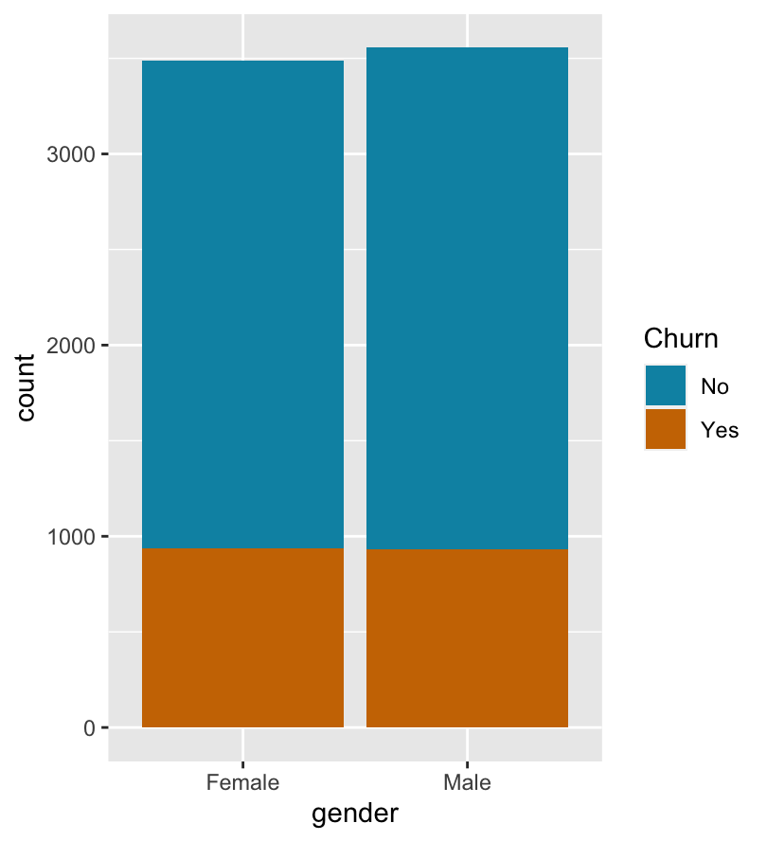
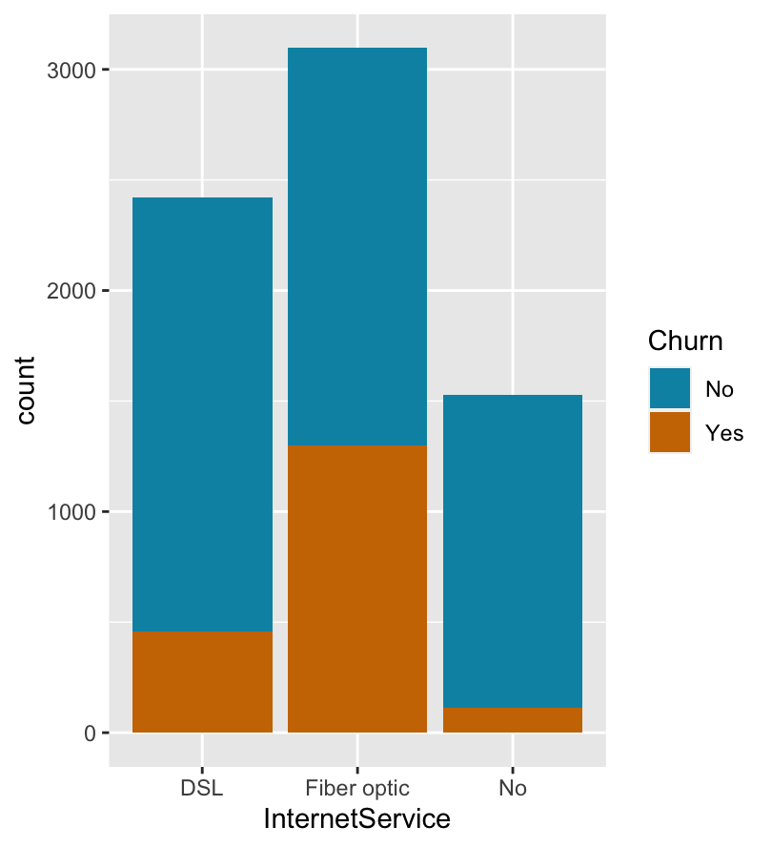
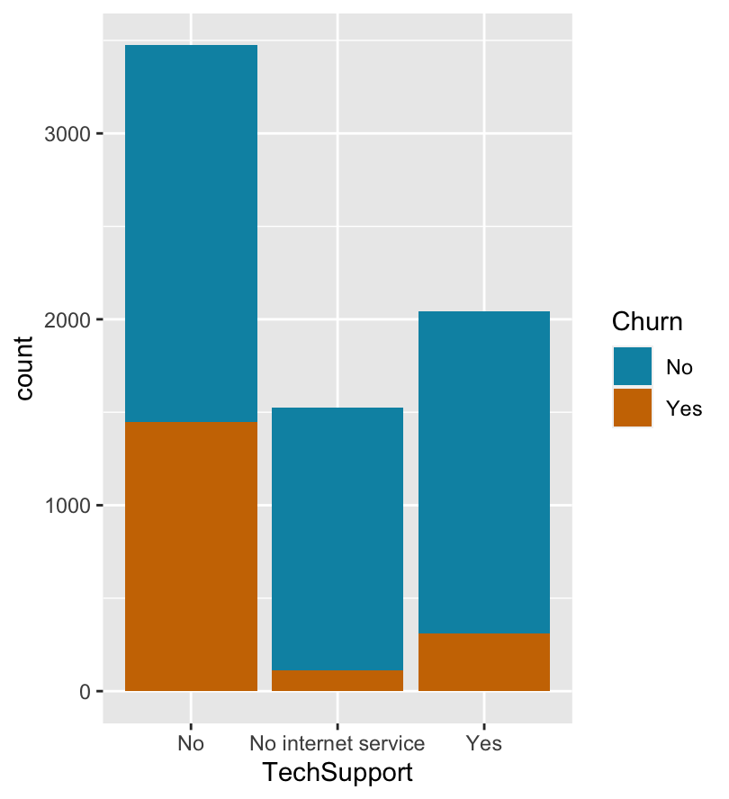
VARIABLES IN THE DATASET

Slide 8
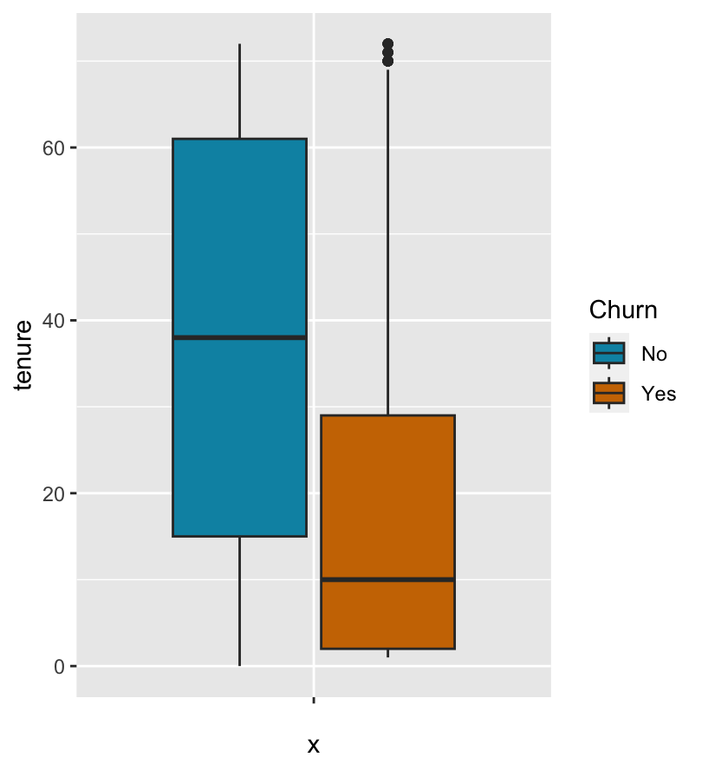
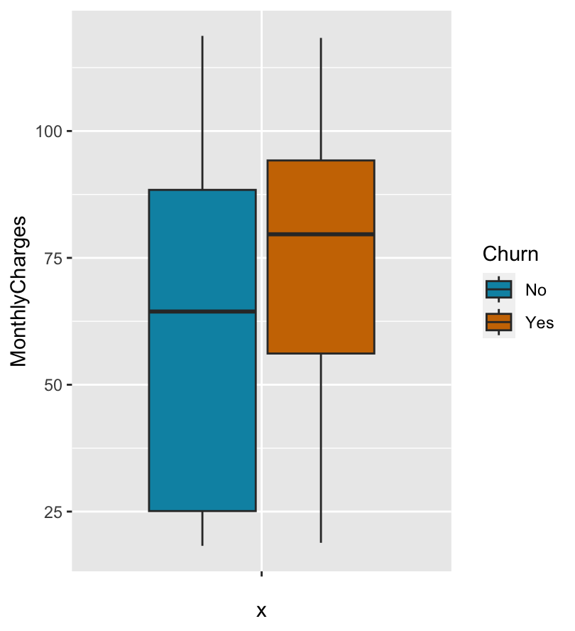
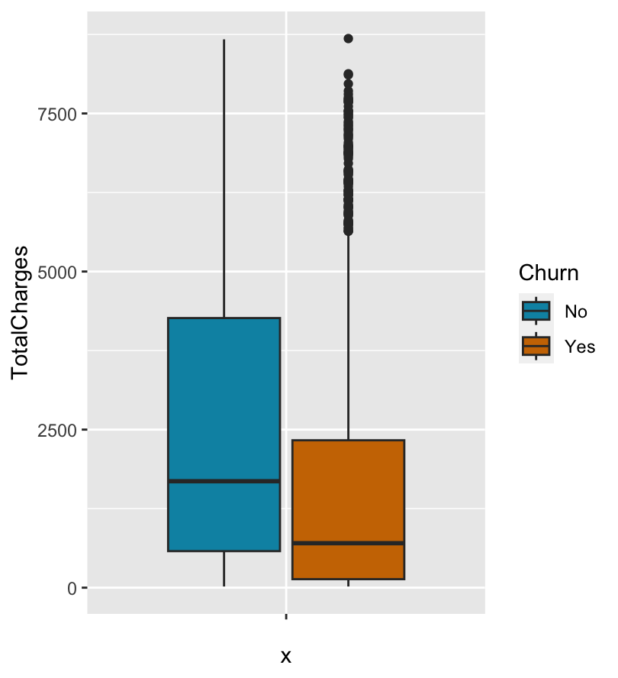
FEATURES - Ctnd

Slide 9
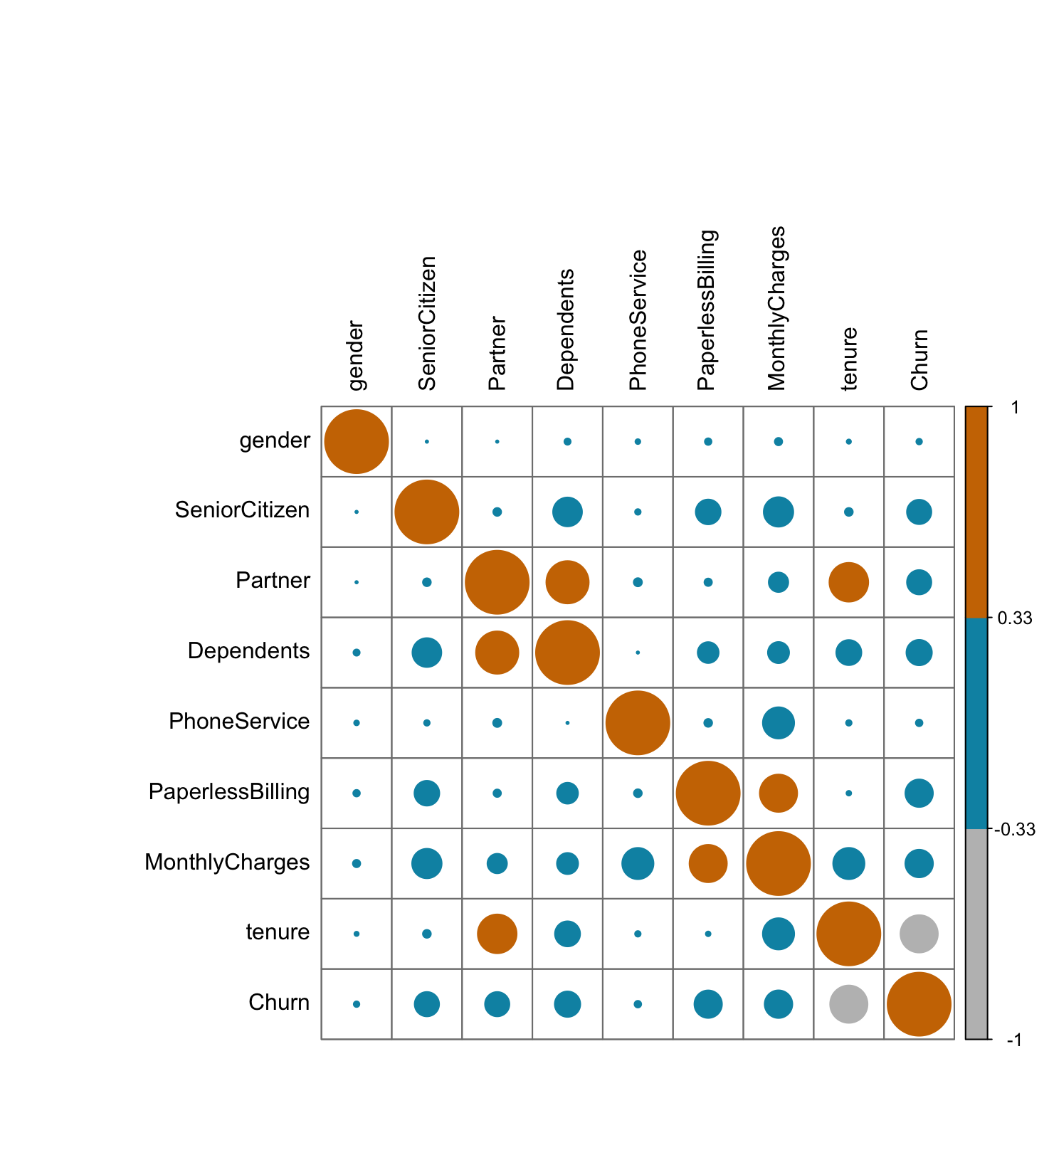
CORRELATION HEATMAP

Slide 10
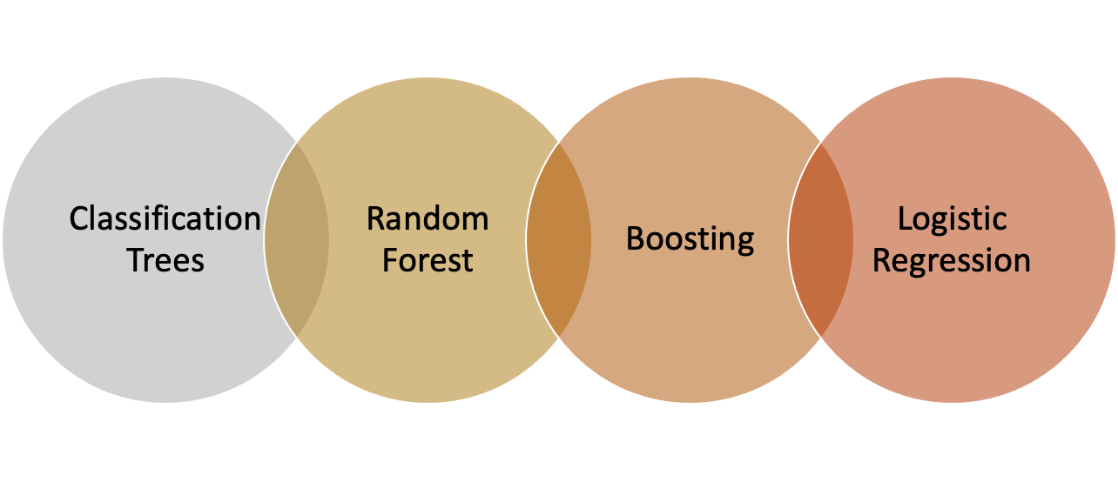
MODELS TESTED
Notes:
Ok so we’ve seen the dataset
wanted to see which statistical model should be employed that would give us the best measures of success
we tried these 4:
classification trees
Random Forest
Boosting
Logistic regression

Slide 11
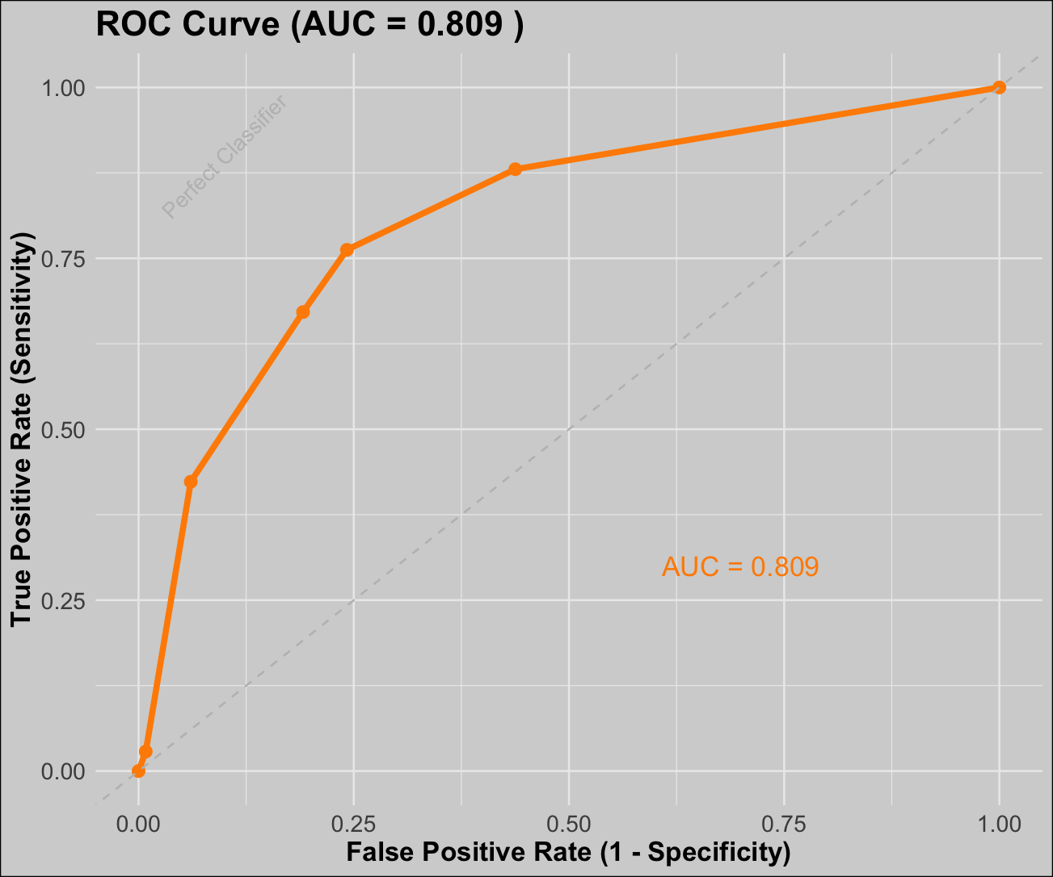
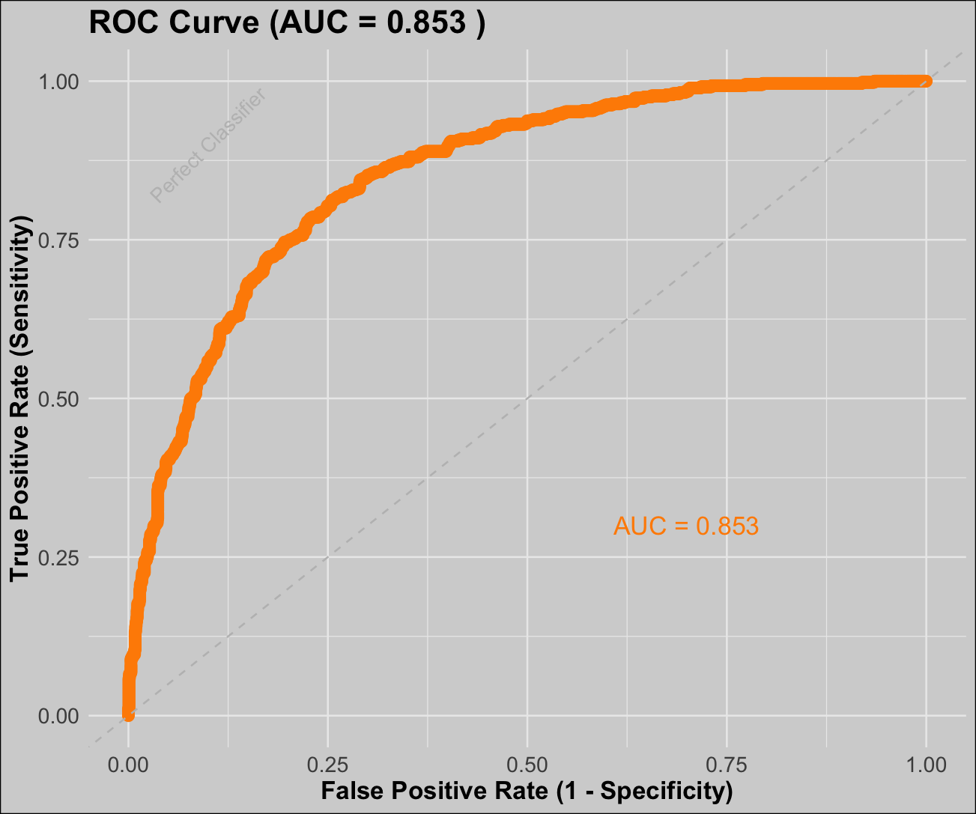
ROC/AUC CURVE
Classification Trees
Random Forest
Notes:
Our main metric of success was using the ROC/AUC curve to select our model
ROC Curve: plots the True Positive rate against the False Positive rate at various different thresholds
AUC is the area under the curve explains how well the model is going to work -
% of time you correctly identify someone is gonna churn
the value varies between 0 and 1 where being closer to 1 indicates a better classifier
As you can see, the AUC values for both classification trees and random forest were pretty similar at about a 0.71 to 0.72 whereas boosting was a 0.84.

Slide 12
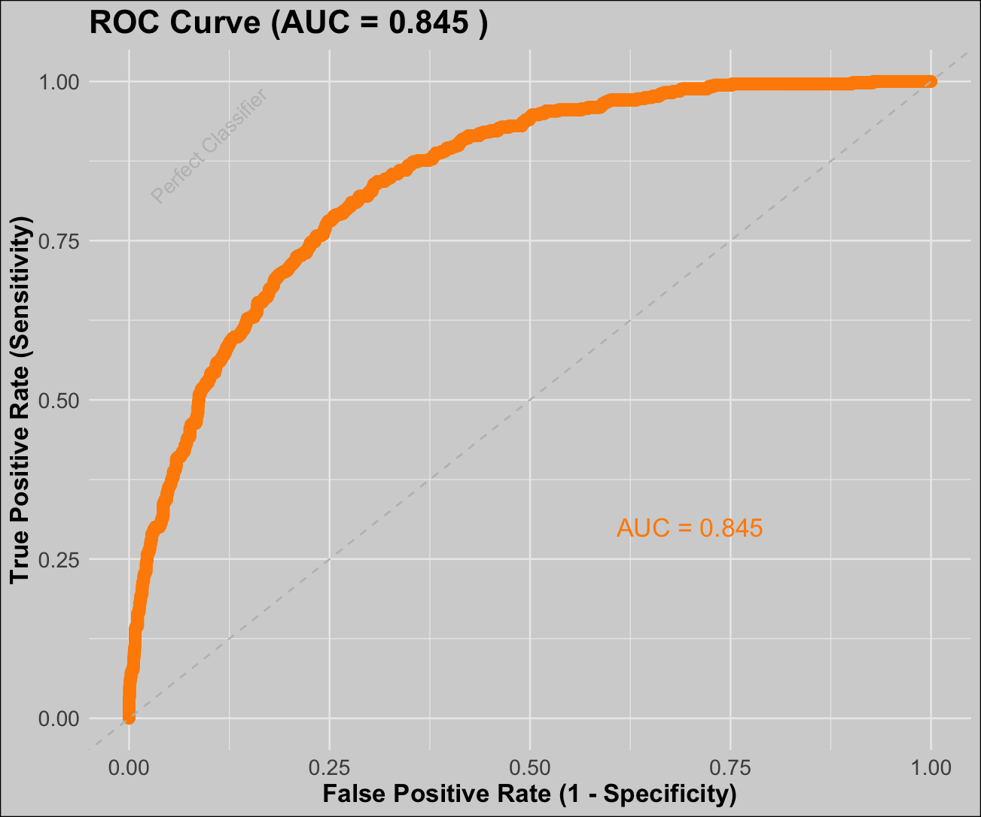
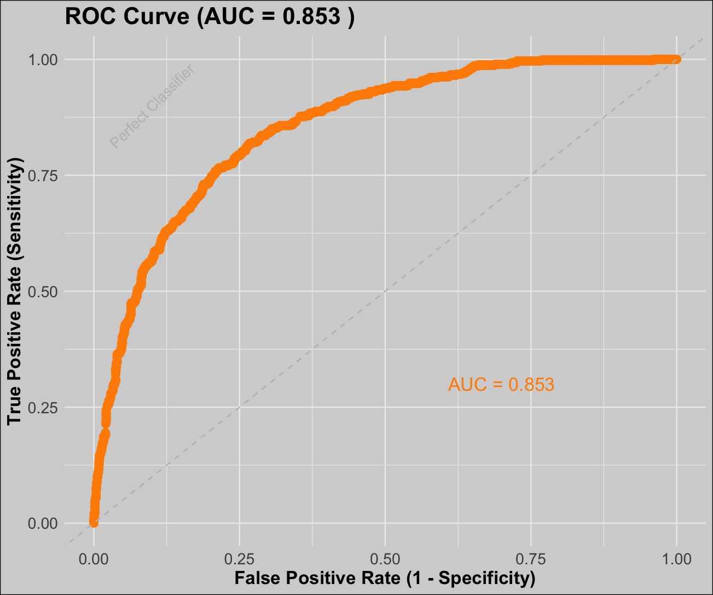
ROC/AUC CURVE
Boosting
Logistic Regression
Notes:
Our main metric of success was using the ROC/AUC curve to select our model
ROC Curve: plots the True Positive rate against the False Positive rate at various different thresholds
AUC is the area under the curve explains how well the model is going to work -
% of time you correctly identify someone is gonna churn
the value varies between 0 and 1 where being closer to 1 indicates a better classifier
As you can see, the AUC values for both classification trees and random forest were pretty similar at about a 0.71 to 0.72 whereas boosting was a 0.84.

Slide 13




BOOSTING MODEL
Converting weak learners into strong one’s
Accuracy: 80.8%
HYPERPARAMETER TUNING
TRAINING THE FINAL MODEL
RELATIVE IMPORTANCE
BEST HYPERPARAMETERS interaction.depth = 20, n.trees = 7000, shrinkage = 0.001
Notes:
Links:
https://www.pexels.com/photo/view-of-high-rise-buildings-during-day-time-302769/

Slide 14
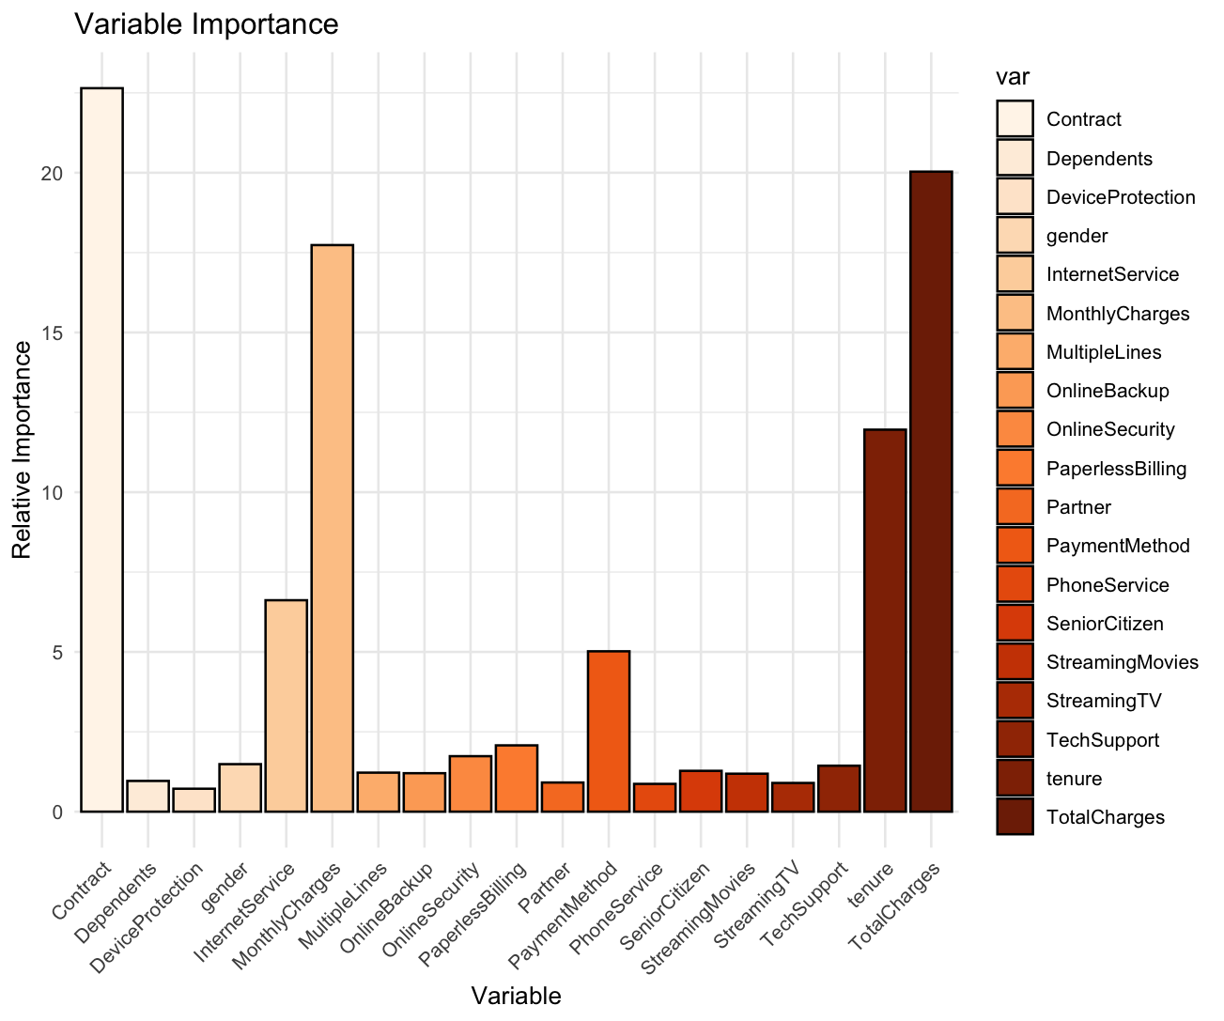
BOOSTING MODEL
Converting weak learners into strong one’s
Notes:
Links:
https://www.pexels.com/photo/view-of-high-rise-buildings-during-day-time-302769/

Slide 15

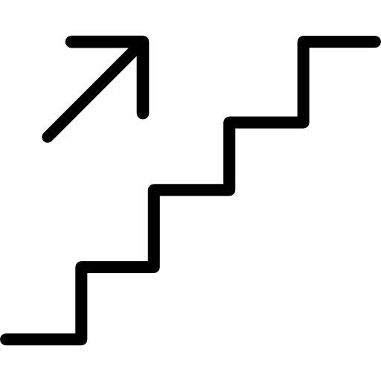
LOGISTIC REGRESSION
FORWARD SELECTION
BACKWARD SELECTION
STEPWISE SELECTION

Slide 16
LOGISTIC REGRESSION
TENURE
STREAMING MOVIES
PHONE SERVICE
3.31%
33.94%
41.41%
DECREASE
INCREASE
DECREASE
in likelihood to churn per month of tenure
in likelihood to churn
in likelihood to churn

Slide 17
IMPLEMENT

Slide 18
APPLIED CONFUSION MATRIX
Predicted Churn
Predicted No Churn
Expected Loss
Unexpected Loss
Actual Churn
Unexpected Retention
Expected Retention
Actual No Churn

Slide 19
APPLIED CONFUSION MATRIX
Predicted Churn
Predicted No Churn
Intervene on outgoing customer
No intervention, lose customer
Actual Churn
Will intervene, keep customer
No intervention, keep customer
Actual No Churn

Slide 20
APPLIED CONFUSION MATRIX
Predicted Churn
Predicted No Churn
Change in Profit = Regained Revenue - Intervention Expenses
Change in Profit = -Revenue
Actual Churn
Change in Profit = -Intervention Expenses
Change in Profit = 0
Actual No Churn

Slide 21
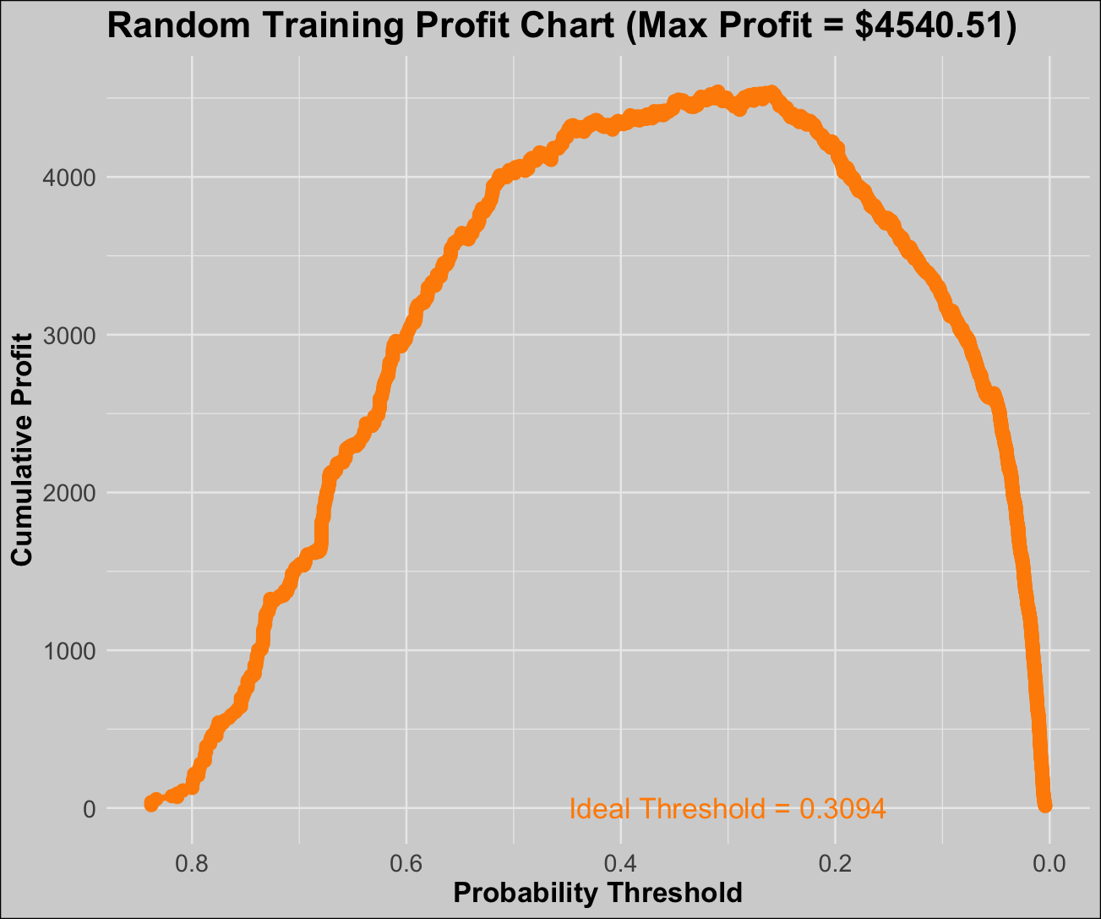
OPTIMAL THRESHOLD
Predicted Churn
Predicted No Churn
429
131
Actual Churn
334
1215
Actual No Churn
Measure | Value
Sensitivity (TPR) | 0.7661
Specificity (TNR) | 0.7844
Ideal Threshold | 0.3092 (train)
Savings | $4540.51

Slide 22
THANK YOU

